Slide 1
Get Started with Arduino
By: Md. Tasnim Islam Tanveer

Slide 2
What is Arduino
Open-source electronics platform.
Combines hardware (microcontroller board) and software (Arduino IDE)
Used for building digital devices & interactive object

Slide 3
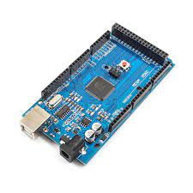
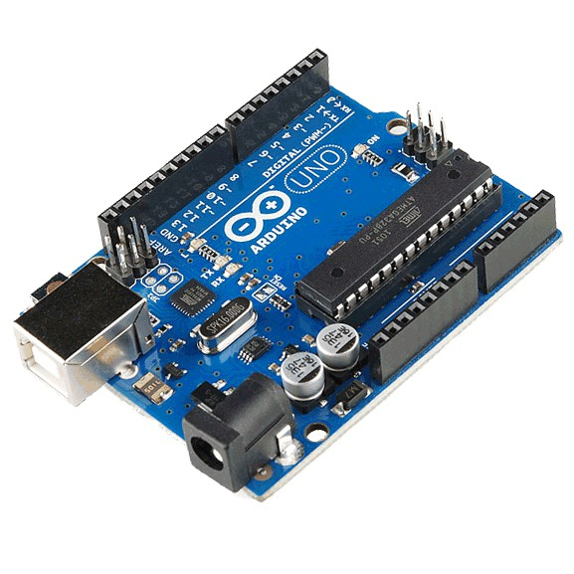
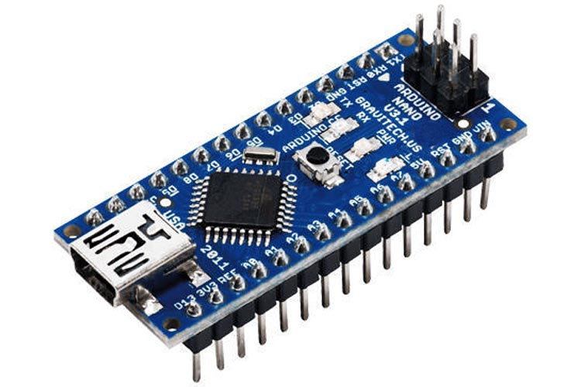
Popular Arduino Boards
Arduino Uno
Arduino Nano
Arduino Mega
Arduino MEGA
Arduino UNO
Arduino NANO

Slide 4
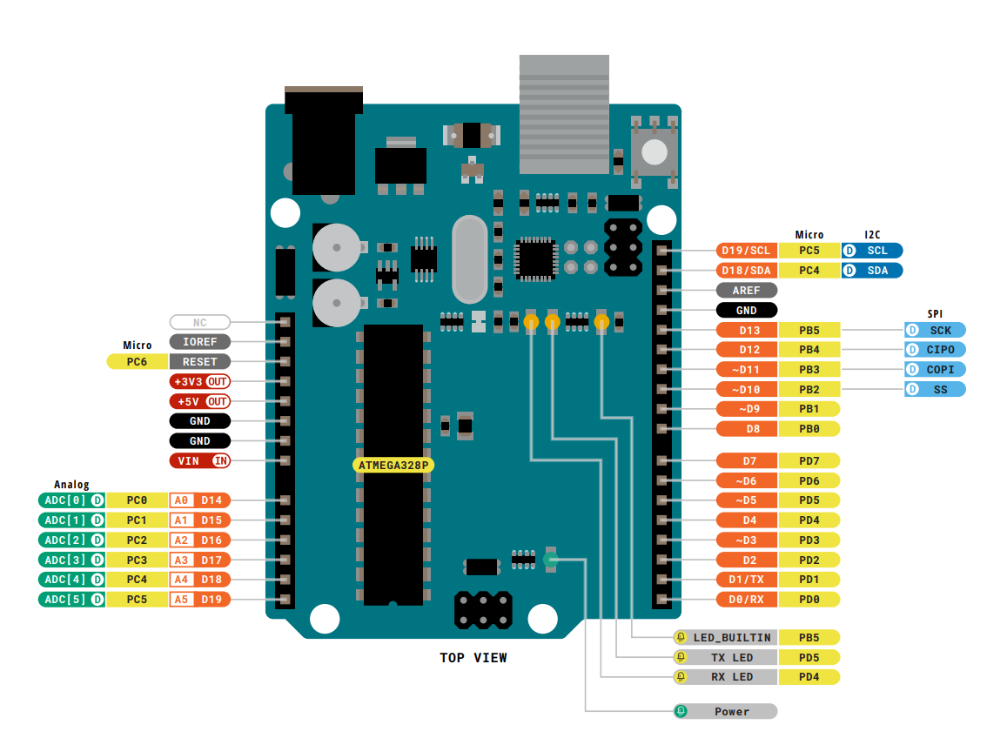
Arduino Uno Pinout
Digital pin: D0 – D19
Analog pin: A0 – A5
Pin D14 to D19 and A0 to A5 are same pins with different name. Since this pins can be use as digital and analog both.
PWM pin: pin with ~ symbol are PWM pins

Slide 5
I/O in Arduino:
Digital : High(0) or Low(1)
High means 5V
Low means 0V
Analog: 0 to 1023
0 means 0.00 V
512 means ~2.50 V
1023 means 5.00 V
Formula:
Voltage= (analog value/1023)*5

Slide 6
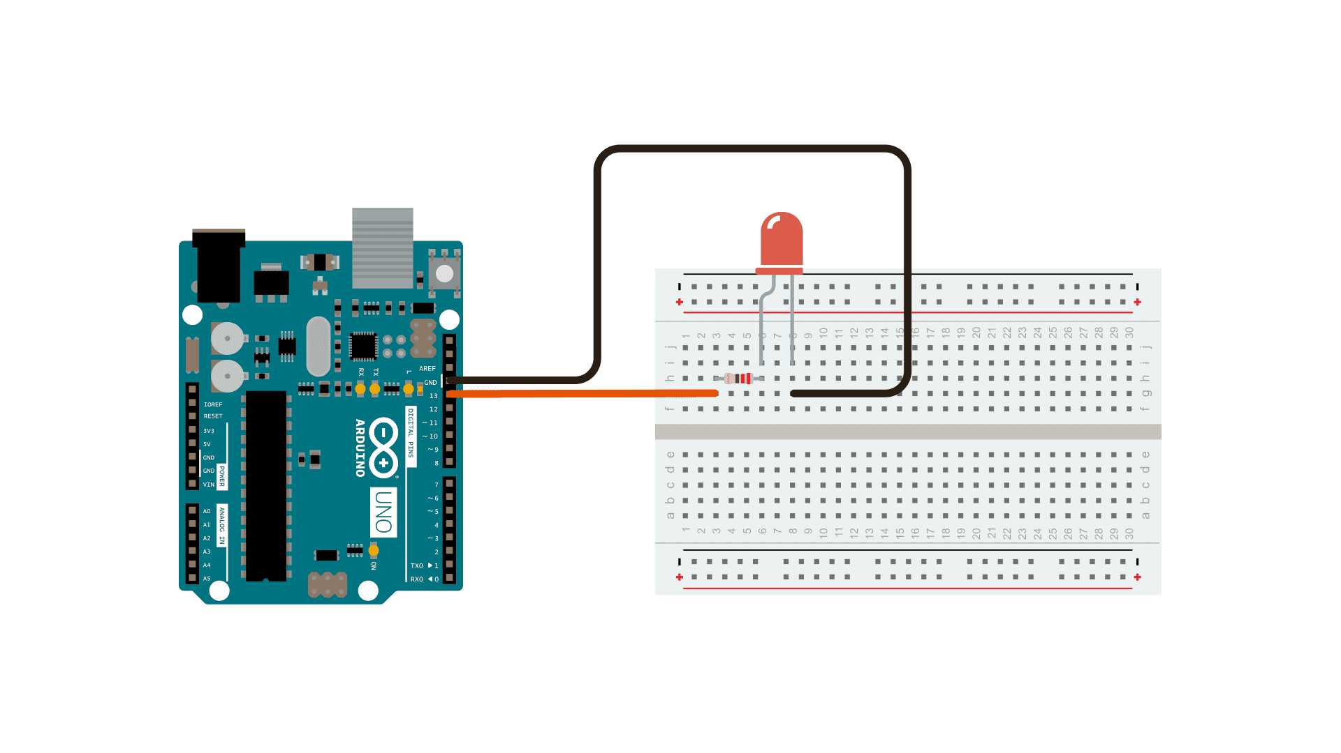
Digital Output:
Possible Outputs :
HIGH (5V)
LOW (0V)
LED Blink: (Code)
LED Blink: (Circuit)
void setup() {
pinMode(13, OUTPUT); // Pin 13 is the onboard LED
}
void loop() {
digitalWrite(13, HIGH); // Turn LED on
delay(1000); // Wait 1 second
digitalWrite(13, LOW); // Turn LED off
delay(1000); // Wait 1 second
}

Slide 7
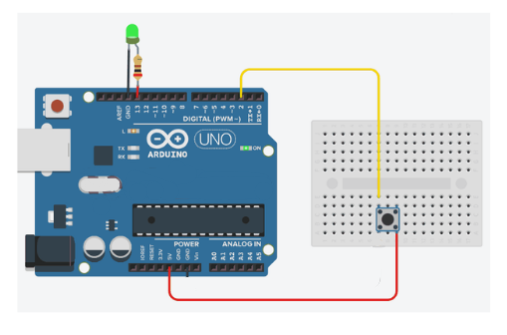
Digital Input:
LED ON/OFF: (Circuit)

Slide 8
Digital Input:
LED ON/OFF: (Code)
int buttonPin = 2; // Push button connected to pin 2
int ledPin = 13; // Onboard LED
void setup() {
pinMode(buttonPin, INPUT); // Button pin as input
pinMode(ledPin, OUTPUT); // LED pin as output
}
void loop() {
int buttonState = digitalRead(buttonPin); // Read button value
if (buttonState == HIGH) { // If button is pressed
digitalWrite(ledPin, HIGH); // LED ON
} else {
digitalWrite(ledPin, LOW); // LED OFF
}
}

Slide 9
Any Problem???

Slide 10
Here is the Solution:
int buttonPin = 2; // Push button connected to pin 2
int ledPin = 13; // Onboard LED
void setup() {
pinMode(buttonPin, INPUT_PULLUP); // Button pin as input
pinMode(ledPin, OUTPUT); // LED pin as output
}
void loop() {
int buttonState = digitalRead(buttonPin); // Read button value
if (buttonState == LOW) { // If button is pressed
digitalWrite(ledPin, HIGH); // LED ON
}
else {
digitalWrite(ledPin, LOW); // LED OFF
}
}

Slide 11

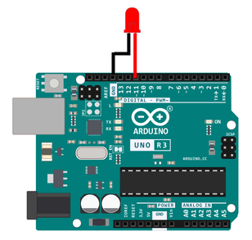
Analog Output
int ledPin = 11; //LED Pin
void setup(){
pinMode(ledPin,OUTPUT);
}
void loop(){
for(int i=0; i<=255; i++){
analogWrite(ledPin,i);
delay(10);
}
for(int i=255; i>= 0; i--){
analogWrite(ledPin,i);
delay(10);
}
}

Slide 12
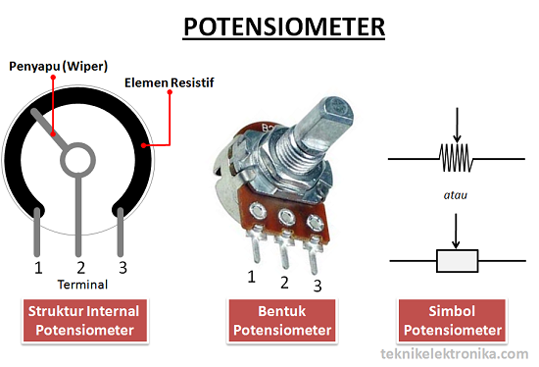
Analog Input:
Let’s Know about potentiometer:

Slide 13
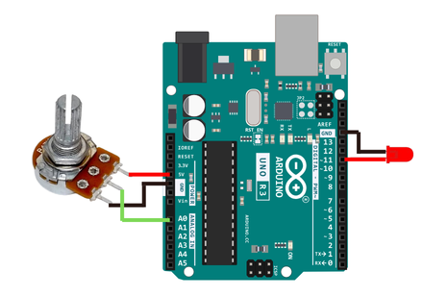
Analog Input:
int potPin = A0; //Potentiometer Pin
int ledPin = 11; //LED Pin
void setup(){
pinMode(potPin,INPUT);
pinMode(ledPin,OUTPUT);
Serial.begin(9600);
}
void loop(){
int potValue = analogRead(potPin);
int cnValue = potValue*((float)255/1023);
Serial.print("Analog Value: ");
Serial.print(potValue);
Serial.print(" PWM Value: ");
Serial.println(cnValue);
analogWrite(ledPin,cnValue);
}

Slide 14
Thank You

